Slide 1
Chapter One Basics of Android, First App: HelloAndroid

Slide 2
Learning Objectives
Get familiar with Android Studio, the Development Environment
Learn about and edit the various files defining an app
Learn how to run and debug an app

Slide 3
Hello Android (1 of 2)
Mobile Apps
The Development Environment
Hello Android App
The XML layout file: activity_main.xml
Other XML files: strings.xml, styles.xml, dimens.xml, colors.xml.

Slide 4
Hello Android (2 of 2)
Running in the emulator
Running on a device
The Activity (MainActivity) class
Debugging the app: Using Logcat

Slide 5
Mobile Apps
The two major operating systems are iOS and Android.
There are over 1 million apps in Google Play (Android).
There are also over 1 million apps in the App Store (Apple—iOS).

Slide 6
Android—Development Environment (1 of 2)
Android Studio is becoming the industry-standard IDE. (Eclipse used to be the standard, but Google no longer supports it.)
Java SDK: Java Standard Development Kit
Android SDK: Android Development Kit (Libraries for Android)

Slide 7
Android—Development Environment (2 of 2)
To set up the development environment, we can download it at:
https://developer.android.com/studio/index.html

Slide 8
Hello Android (1 of 2)
Open Android Studio.
Choose Start a new Android Studio project.
OR
Inside Android Studio, File, New Project.
In the dialog box, enter the project name and the package name.

Slide 9
Hello Android (2 of 2)
Click Next, then select the default choices in the following dialog boxes (choose Empty Activity when that dialog box shows up), then click on Finish.
A whole directory structure is created for the project.

Slide 10
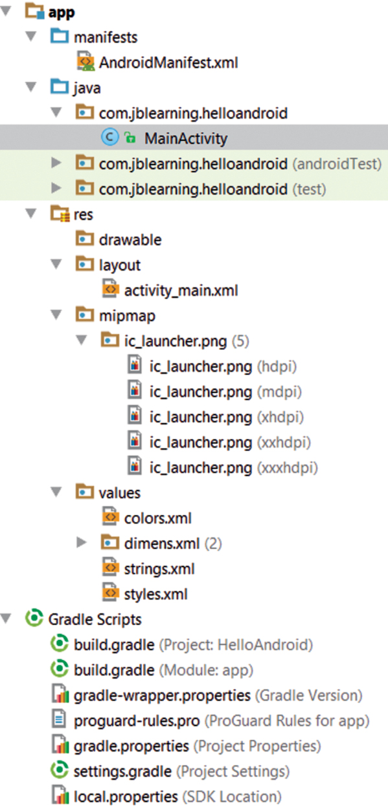

Slide 11
Directory Structure
java: Java source files
res: resource files, such as utility xml files for defining strings, styles, menus, layouts, dimensions, as well as images, sounds, … A resource id is automatically generated for these files.

Slide 12
Activity (1 of 7)
The class MainActivity (default name) is located in the src directory.
It extends AppCompatActivity class (in android.support.v7.app package).

Slide 13
Activity (2 of 7)
AppCompatActivity is a subclass of Activity.
An Activity provides a screen with which users can interact.
This class is meant to be used as the Controller for the app.

Slide 14
Activity (3 of 7)
The onCreate method is called automatically.
Inside the onCreate method, we should create the initial View for the app, controlled by this Activity.

Slide 15
Activity (4 of 7)
Inside onCreate, after calling the super method, we set the View for this Activity by calling setContentView, a method inherited from the Activity class. Its API is: void setContentView( int layoutResID )
layoutResID is a Resource.

Slide 16
Activity (5 of 7)
Inside onCreate:
setContentView( R.layout.activity_main ); ➔ the View for this Activity is set to be the one defined in the activity_main.xml file.

Slide 17
Activity (6 of 7)
activity_main.xml is an xml file, a resource, located in the layout directory of the res directory.
It was automatically created when we created the project.
It is an XML file that defines a simple layout for this Hello World app.

Slide 18
Activity (7 of 7)
We access activity_main.xml using the syntax R.layout.activity_main.
activity_main is a static constant of the static final class layout defined inside the R class (in the R.java file—search for R.java to find it) that was automatically created when we created the project.
R stands for resources and “represents” the res directory.

Slide 19
Previewing the App (1 of 2)
Android Studio lets us preview a GUI defined in a layout XML file.
Click on View, Tool Windows, then Preview.

Slide 20
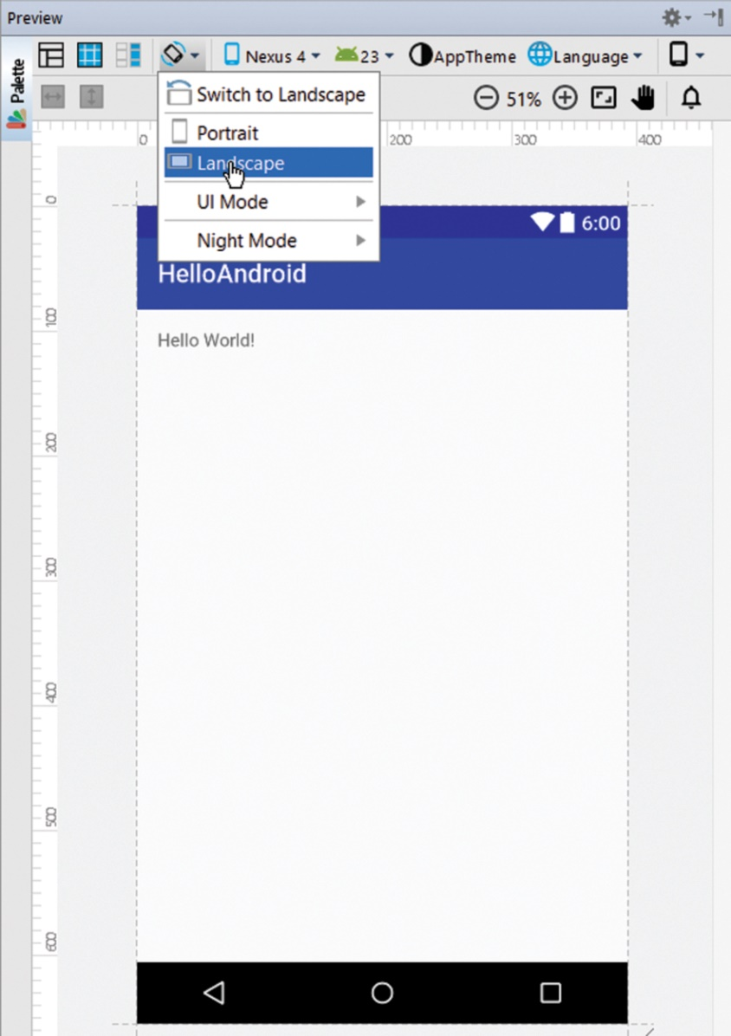
Previewing the App (2 of 2)
We can customize the preview:
Landscape (horizontal) vs portrait (vertical) orientation.
Choose a device.
Choose a theme.

Slide 21
activity_main.xml
The file activity_main.xml, in the layout directory of the res directory, defines the layout for this Hello World app.
It is automatically generated and written in XML.

Slide 22
XML (1 of 4)
XML stands for eXtensible Markup Language.
See full documentation at http://www.w3.org/XML/
We can think of XML as a markup language similar to HTML, but with user-defined tags.

Slide 23
XML (2 of 4)
A non-empty element uses this syntax:
<tagName attribute1 = "value1" attribute2 = "value2" … >Element Content</tagName>
For example:
<app language = "Java" version = "7.0">Hello Android</app>

Slide 24
XML (3 of 4)
If an element has no content (the element is empty), then we can use this syntax:
<tagName attribute1 = "value1" attribute2 = "value2" … />
For example:
<dev ide = "Studio" version = "1"/>

Slide 25
XML (4 of 4)
Elements can be nested as in:
<a>
<b>hello</b>
</a>
There are rules for naming tags: they are similar to naming identifiers in java.

Slide 26
activity_main.xml (1 of 9)
There are two elements in activity_main.xml:
A RelativeLayout and a TextView.
The TextView element is nested inside the RelativeLayout element.
A RelativeLayout organizes elements in relation to each other and in relation to their parent View.

Slide 27
activity_main.xml (2 of 9)
<?xml version="1.0" encoding="utf-8"?> <RelativeLayout …> <TextView …/> </RelativeLayout>

Slide 28
activity_main.xml (3 of 9)
The RelativeLayout element has several attributes.
The android:layout_width and android:layout_height attributes define the size of the RelativeLayout.
Their value match_parent means that it will be as big as its parent element, which is the screen in this case.

Slide 29
activity_main.xml (4 of 9)
<RelativeLayout … android:layout_width="match_parent" android:layout_height="match_parent"
android:paddingBottom=
"@dimen/activity_vertical_margin" …
>

Slide 30
activity_main.xml (5 of 9)
The TextView element is empty (has no content) and has three attributes.
A TextView element is an instance of the TextView class, which encapsulates the concept of a label.

Slide 31
activity_main.xml (6 of 9)
<TextView android:layout_width="wrap_content" android:layout_height="wrap_content" android:text="Hello World!"/>

Slide 32
activity_main.xml (7 of 9)
The three attributes are: android:layout_width, android:layout_height,
and android:text.

Slide 33
activity_main.xml (8 of 9)
The android:layout_width and android:layout_height attributes define the size of the TextView.
The value wrap_content means that it will be as small as possible so that their contents fit inside it.
The element “wraps” around its content.
By default, it appears at the top left corner of the screen.

Slide 34
activity_main.xml (9 of 9)
The android:text attribute specifies the content of the TextView element.
Its value is “Hello World!”.

Slide 35
dimens.xml (1 of 5)
The dimens.xml file is another (automatically generated) XML file; its contents comply with XML syntax.
It is used to define dimensions.

Slide 36
dimens.xml (2 of 5)
<resources> <!-- Default screen margins, per the Android Design
guidelines. --> <dimen name="activity_horizontal_margin">16dp</dimen> <dimen name="activity_vertical_margin">16dp</dimen> </resources>
activity_horizontal_margin and activity_vertical_margin are used in activity_main.xml.

Slide 37
dimens.xml (3 of 5)
The syntax for defining a dimension is
<dimen name = "dimensionName"> valueOfDimension</dimen>

Slide 38
dimens.xml (4 of 5)
We can change the margin values as follows:
<resources> <dimen name="activity_horizontal_margin">50dp</dimen> <dimen name="activity_vertical_margin">100dp</dimen> </resources>

Slide 39
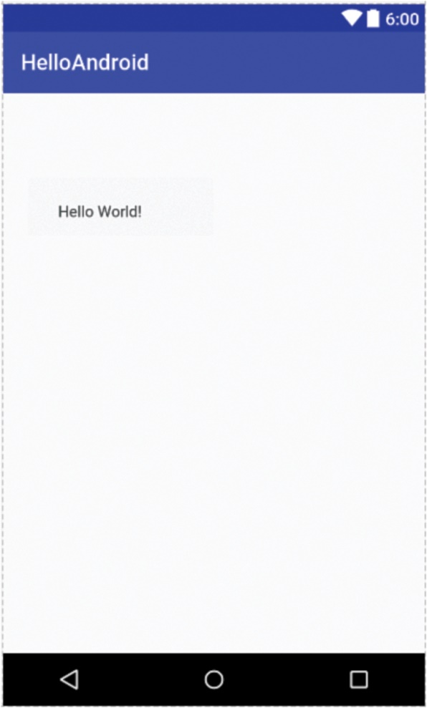
dimens.xml (5 of 5)
The preview shows the new margins:

Slide 40
strings.xml (1 of 4)
The strings.xml is another (automatically generated) XML file; its contents comply with XML syntax.
One string is defined in the strings.xml file: app_name.

Slide 41
strings.xml (2 of 4)
<resources> <string name="app_name">HelloAndroid</string> </resources>

Slide 42
strings.xml (3 of 4)
The syntax for defining a string is
<string name = "stringName">valueOfString</string>
The value of the string app_name is
HelloAndroid (that is the name we chose for the app when we created it)

Slide 43
strings.xml (4 of 4)
We can edit strings.xml, for example modify the value of hello_world as follows:
<string name="app_name">My First App</string>
When we preview or run the app again, the title of the app is My First App.

Slide 44
activity_main.xml (1 of 2)
We can also edit activity_main.xml, for example center the TextView as follows:
<TextView android:layout_width="wrap_content" android:layout_height="wrap_content" android:text="Hi there"/>

Slide 45
activity_main.xml (2 of 2)
When we run the app again, the text inside the TextView says “Hi there” instead of “Hello World!” as before.

Slide 46
styles.xml (1 of 5)
The styles.xml file is another (automatically generated) XML file; its contents comply with XML syntax.
It is used to define styles that the app uses.

Slide 47
styles.xml (2 of 5)
<resources> <!-- Base application theme. --> <style name="AppTheme"
parent="Theme.AppCompat.Light.DarkActionBar">
<!-- Customize your theme here. --> <item name="colorPrimary">@color/colorPrimary</item> <item name="colorPrimaryDark">@color/colorPrimaryDark</item> <item name="colorAccent">@color/colorAccent</item> </style> </resources>

Slide 48
styles.xml (3 of 5)
We can modify a style by adding an item element using this syntax:
<item
name="styleAttribute">valueOfItem</item>

Slide 49
styles.xml (4 of 5)
The name of the style attribute that specifies the text size inside a TextView is android:textSize. We change the default text size to 40.
<item name="android:textSize">40sp</item>

Slide 50
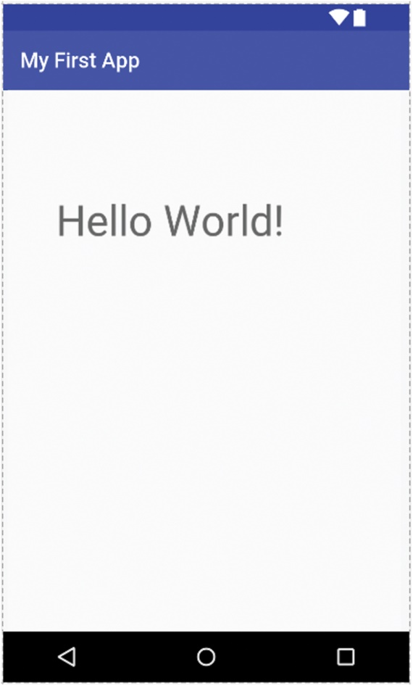
styles.xml (5 of 5)
The preview shows the effect of the new text size:

Slide 51
colors.xml (1 of 3)
The colors.xml file is another (automatically generated) XML file; its contents comply with XML syntax.
It is used to define colors.

Slide 52
colors.xml (2 of 3)
<?xml version="1.0" encoding="utf-8"?> <resources> <color name="colorPrimary">#3F51B5</color> <color name="colorPrimaryDark">#303F9F</color> <color name="colorAccent">#FF4081</color> </resources>

Slide 53
colors.xml (3 of 3)
The syntax for defining a color is
<color name = "colorName"> valueOfColor</color>
The color value is defined using hexadecimal notation (more on that later in the book).

Slide 54
Hexadecimal Color Value (1 of 2)
#rrggbb (uses RGB color system).
rr = amount of red in color
gg = amount of green in color
bb = amount of blue in color.

Slide 55
Hexadecimal Color Value (2 of 2)
#rrggbb (uses RGB color system).
Values vary from 00 (0) to FF (255)
That means we can define 256 × 256 × 256 = 16.7 million colors.

Slide 56
colors.xml (1 of 2)
If we modify the value of colorPrimary to red (#FF0000):
<?xml version="1.0" encoding="utf-8"?> <resources> <color name="colorPrimary">#FF0000</color> <color name="colorPrimaryDark">#303F9F</color> <color name="colorAccent">#FF4081</color> </resources>

Slide 57
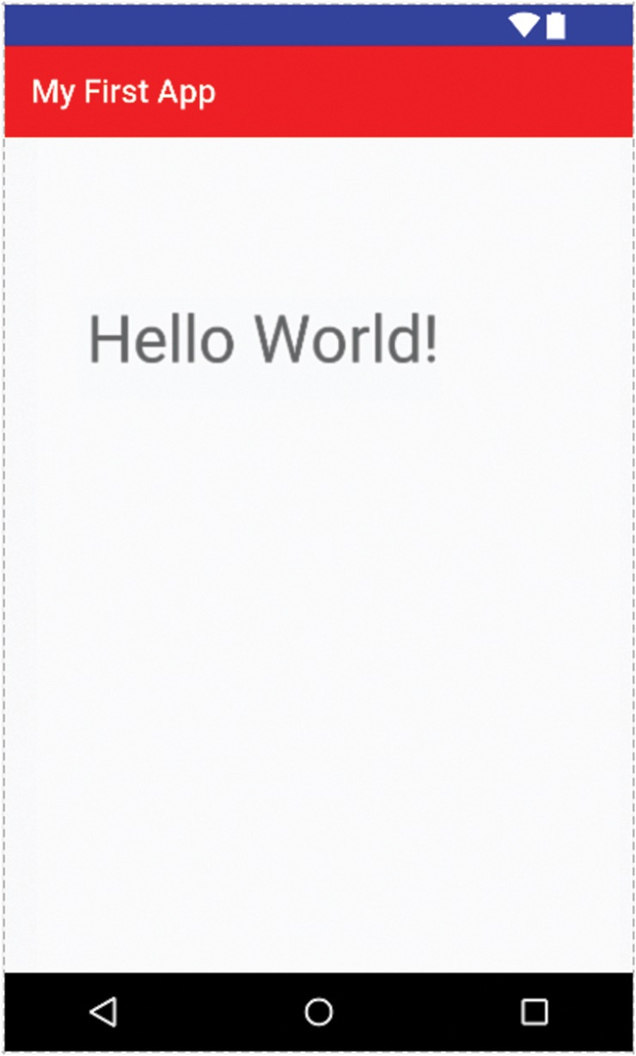
colors.xml (2 of 2)
Previewing the app after modifying the value of color Primary to red (#FF0000):

Slide 58
Running the App
We will first run the app inside the emulator.
An Android Virtual Device (AVD) should have been created when we installed Android Studio (probably for a Nexus 5).
We can create more AVDs that will emulate other existing Android devices.

Slide 59
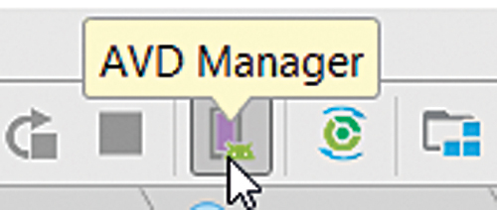
Creating an AVD (Android Virtual Device)
Click on Tools, then Android, then AVD Manager, OR click on the AVD Manager icon.
The AVD Manager opens.
Click on Create Virtual Device.

Slide 60
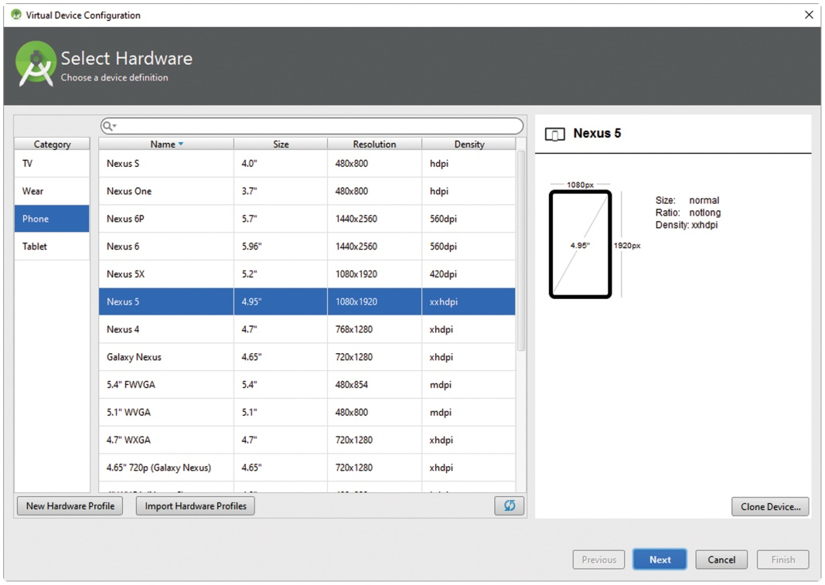
Creating an AVD
Choose from the list of possible AVDs.
Follow the instructions of the dialog box until the AVD is created.

Slide 61
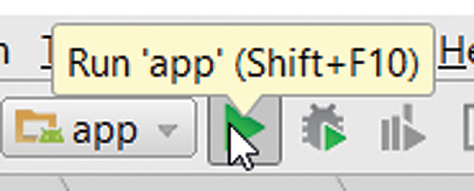
Running (1 of 4)
Click on the Run icon, or click on Run, then Run app.
A dialog box appears asking you to choose a device.

Slide 62
Running (2 of 4)
You can choose an actual device (if it is connected to your computer).
The actual device should show at the top of the dialog box ("Choose a running device").
We can select from a list of AVDs at the bottom of the dialog box.

Slide 63
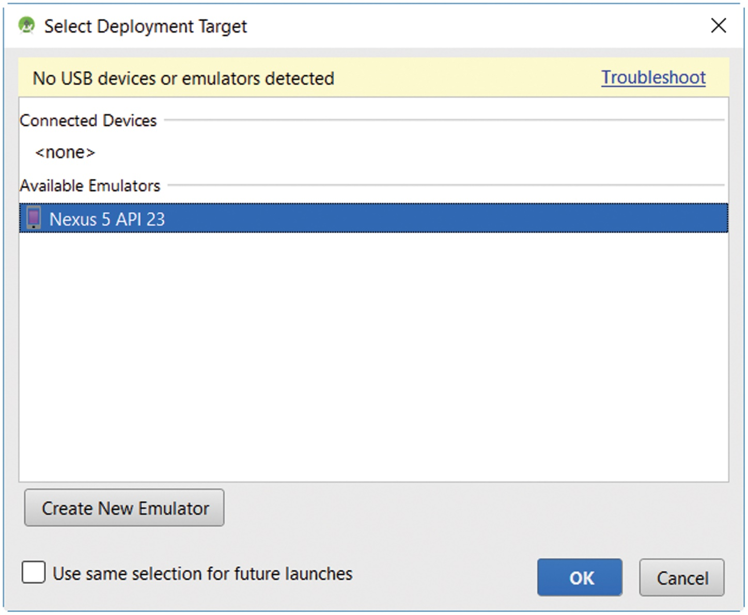
Running (3 of 4)

Slide 64
Running (4 of 4)
If we select an AVD, then the emulator will be launched.
It may take a couple of minutes to show and run.
➔ it is better to leave the emulator open (rather than close it every time we run).
The app should be running inside the emulator.

Slide 65
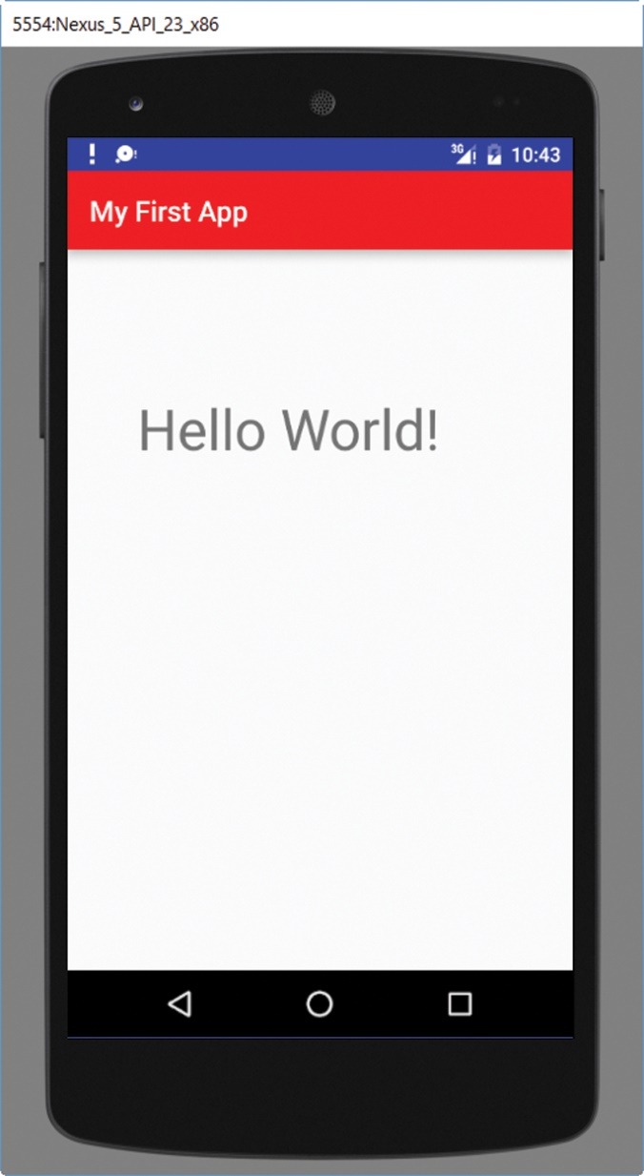
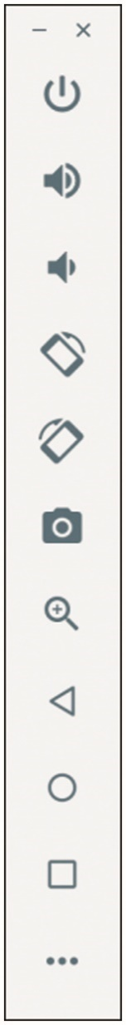
Running Inside the Emulator

Slide 66
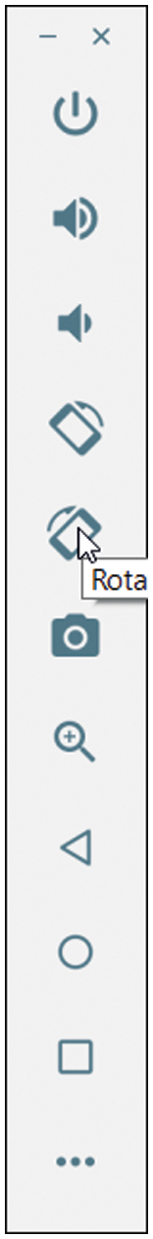
Running
You can rotate the app as it is running inside the emulator.
Click on the rotate button on the tool bar.

Slide 67
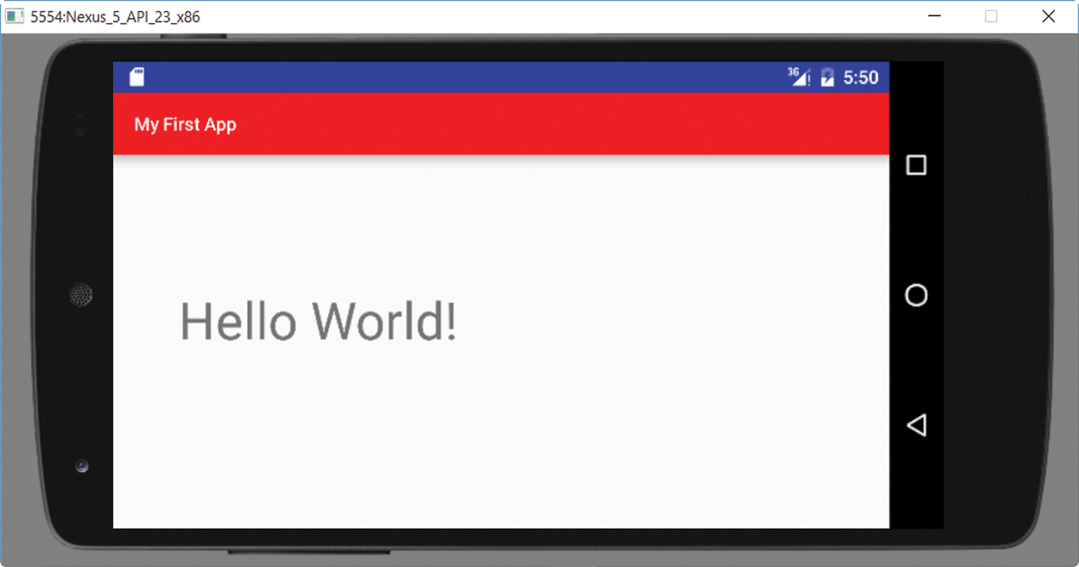
Running Inside the Emulator
After rotating the app.

Slide 68
Instant Run (1 of 2)
An interesting recent feature of Android Studio is Instant Run.
With Instant Run, we can modify some selected components of an app, for example the strings.xml file.
Click on the Run icon, and the emulator automatically updates the app on the fly. Instant Run is enabled by default.

Slide 69
Instant Run (2 of 2)
If we want to disable Instant Run, we can choose File, Settings, and within the Build, Execution, Deployment section, select Instant Run, and then edit it.
If we do not want to use Instant Run, we can uncheck it and check Restart activity on code changes.

Slide 70
Feedback and Debugging
We can send output to the console in addition to displaying data on the screen.
For this, we can use various static methods of the Log class, located in the android.util package.

Slide 71
Log Class (1 of 2)
Selected methods include d, e, i, v, w. They all have the same parameter list and return type; for example, the API of d is
public static void d( String tag,
String message )
d stands for debug, e for error, i for info, v for verbose, and w for warning.

Slide 72
Log Class (2 of 2)
public static void d( String tag,
String message )
tag identifies the source of the message and can be associated with a “filter”.
message is the String to be output.

Slide 73
Logcat
Output from logging statements will show in the lower panel, below the source code, if we select the Logcat tab.
If the Logcat tab does not show, we should run the app in debug mode at least once (click on the bug icon, next to the run icon), then it will show when we run it.

Slide 74
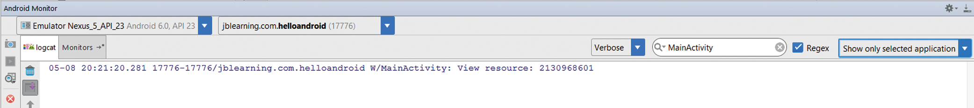
Logcat Output

Slide 75
Logcat
There can be many output messages, so we can filter them. When the filter is selected, only the output whose tag is associated with that filter is shown.

Slide 76
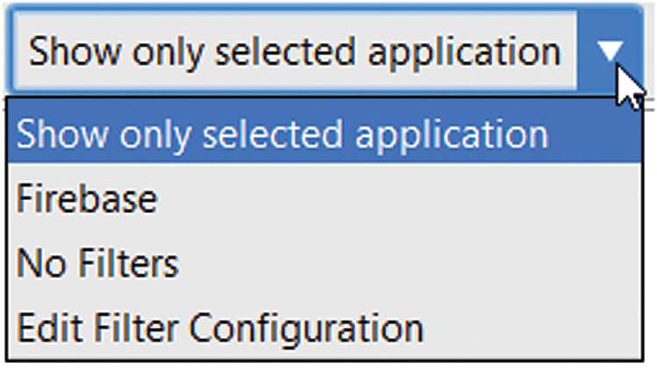
Setting Up a Filter (1 of 2)
To create a filter, click on the combo box on the right of the lower panel, select Edit Filter Configuration.

Slide 77
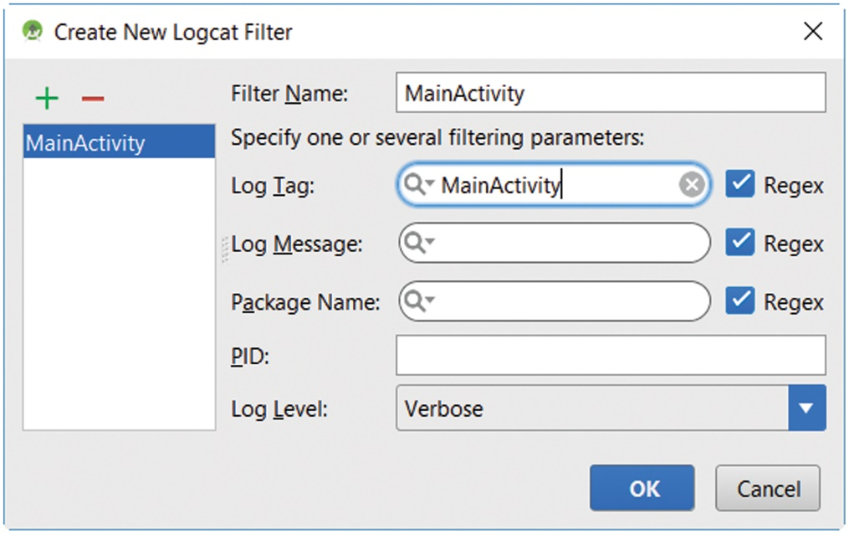
Setting Up a Filter (2 of 2)
Inside the dialog box, enter a name for the filter and a Log tag for it.
For example, the filter name can be MainActivity_jbl, and the tag name can be MainActivity.

Slide 78
Using the Log Class (1 of 3)
Now that a filter has been created along with its tag, we can output messages to Logcat like this:
Log.w( “MainActivity”, “Inside onCreate” );
The tag name is MainActivity.
The output is Inside onCreate.

Slide 79
Using the Log Class (2 of 3)
Example 1.9 shows how we can use logging statements at various places in MainActivity.java.
It shows that we execute inside the onCreate method of the Activity class as well the value of the activity_main resource id.

Slide 80
Using the Log Class (3 of 3)
…
public static String MA = "MainActivity"; …
setContentView( R.layout.activity_main ); Log.w( MA, "View resource: " + R.layout.activity_main ); …

Slide 81
Logcat Output

Slide 82
Using the Debugger (1 of 6)
Android Studio includes a debugger.
We can set up breakpoints, check the values of variables or expressions, step over code line by line, check object memory allocation, …

Slide 83
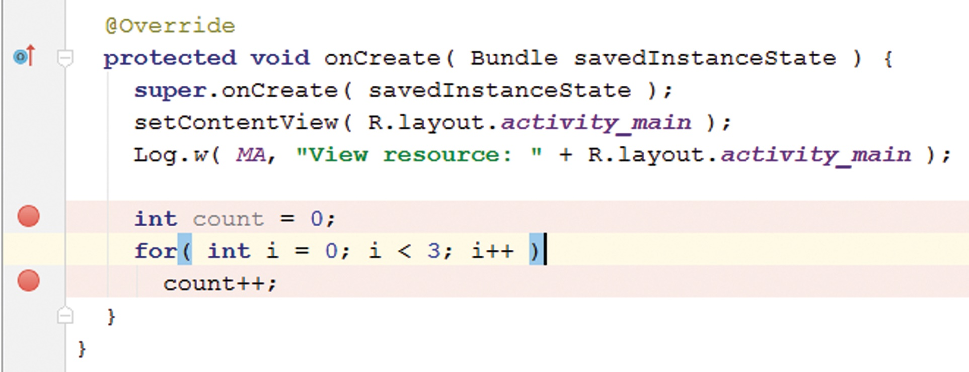
Using the Debugger (2 of 6)
To set up a breakpoint, we click on the left of a statement: an orange filled circle appears.

Slide 84
Using the Debugger (3 of 6)
To run the app in debug mode, we click on the debug icon on the toolbar.
The app runs and stops at the first breakpoint.
The debugger tab is selected in the panel at the bottom of the screen and we can see some debugging information and tools.

Slide 85
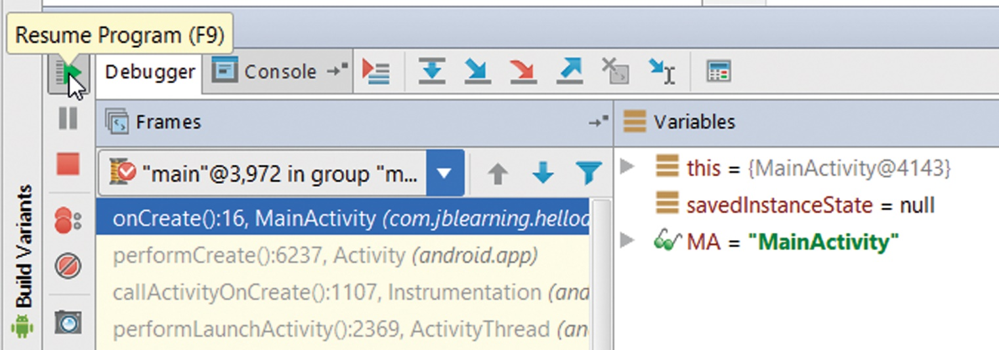
Using the Debugger (4 of 6)
Under Frames, we can see where in the code we are currently executing.
To resume the app, we click on the green Resume icon at the top left of the panel.

Slide 86
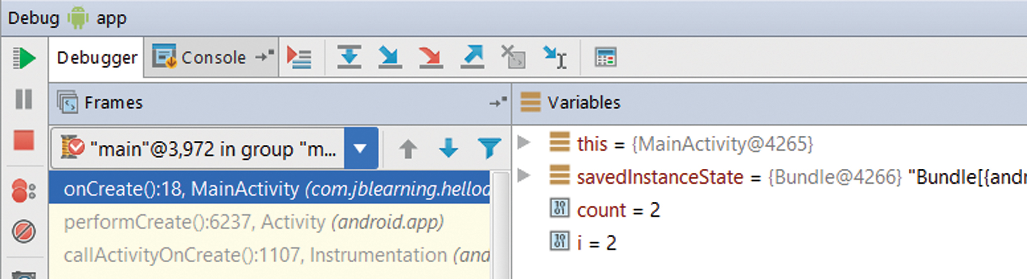
Using the Debugger (5 of 6)
As we resume, stop at breakpoints, and resume the app a few times, the values of the various variables in our app are displayed under Variables.

Slide 87
Using the Debugger (6 of 6)
Under Variables, we can check the values of the various variables, for example MA, which has value MainActivity.

Slide 88
Running on an Actual Device (1 of 5)
To run on an actual device, we need to do two things:
Download a driver for the device.
Connect the Android device to the computer.

Slide 89
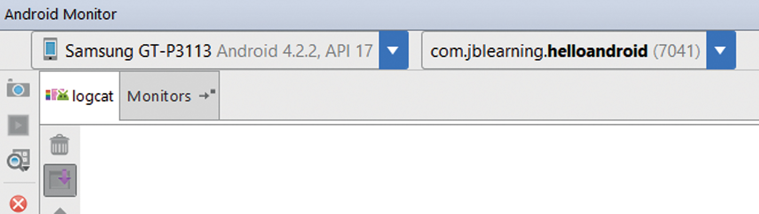
Running on an Actual Device (2 of 5)
Once the device is connected, its name should appear on the left upper corner of the lower pane.

Slide 90
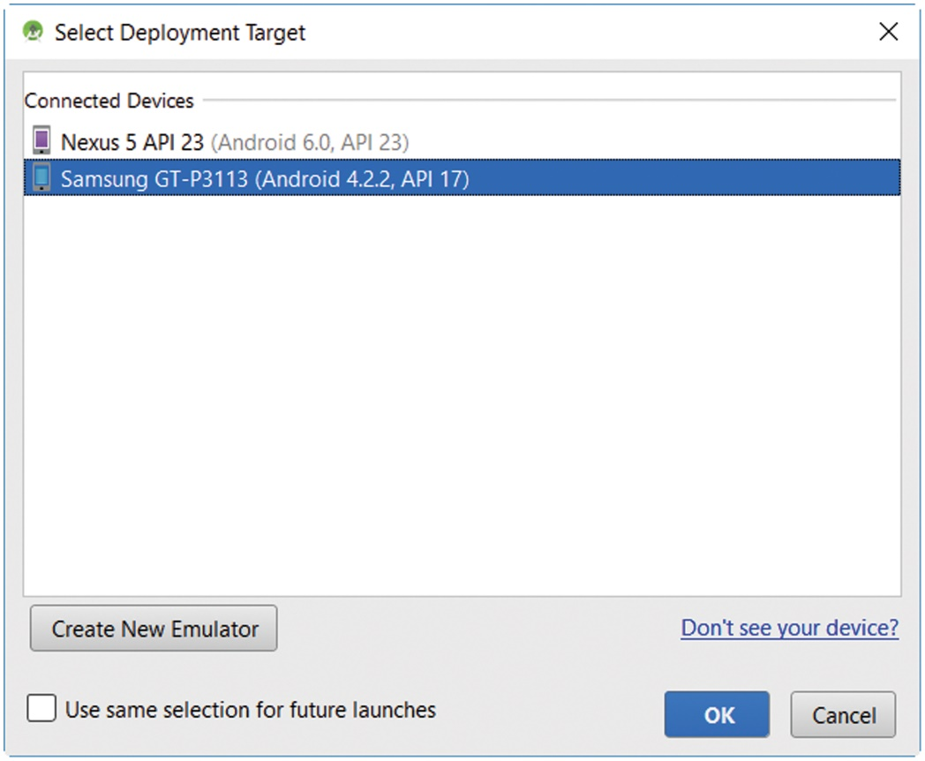
Running on an Actual Device (3 of 5)
When we run, it should appear under "Choose a running device".
Select "Choose a running device" and click on OK.

Slide 91
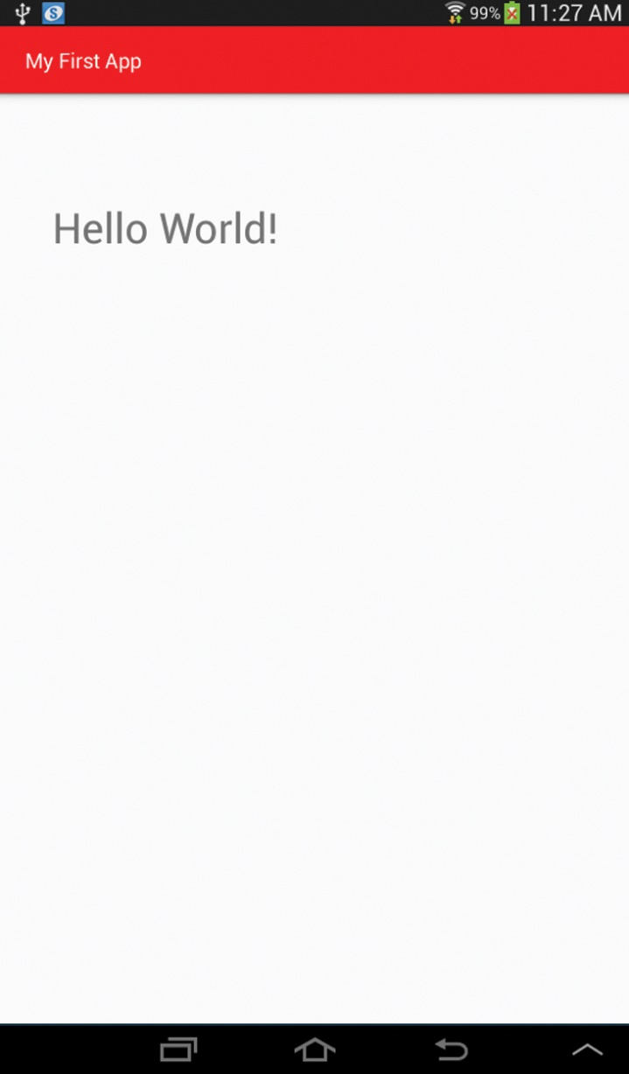
Running on an Actual Device (4 of 5)
The app running inside a tablet

Slide 92
Running on an Actual Device (5 of 5)
If the app is running on a device, we can still log output statements in Logcat.
This is much faster than starting the emulator.

Slide 93
The App Manifest
The AndroidManifest.xml file, located in the manifests directory, specifies the resources that the app uses, such as activities, the file system, the Internet, and hardware resources.
Before a user downloads an app on Google Play, the user is notified about these.

Slide 94
AndroidManifest.xml (1 of 2)
Example 1.11 shows AndroidManifest.xml’s automatically generated version. Among other things, it defines the icon and the label or title for the app.
The text inside the label is the app_name String defined in strings.xml.

Slide 95
AndroidManifest.xml (2 of 2)
We should supply a launcher icon for your app.
This is the visual representation of our app on the home screen or the apps screen.
A launcher icon for a mobile device should be 48 × 48 dp.

Slide 96
Launcher Icon (1 of 2)
To set the launch icon for the app to hi.png, we assign the String @mipmap/hi to the android:icon attribute of the application element in the AmdroidManifest.xml file.
The @mipmap/hi expression defines the resource in the mipmap directory (of the res directory) whose name is hi (note that we do not include the extension).
android:icon="@mipmap/hi"

Slide 97
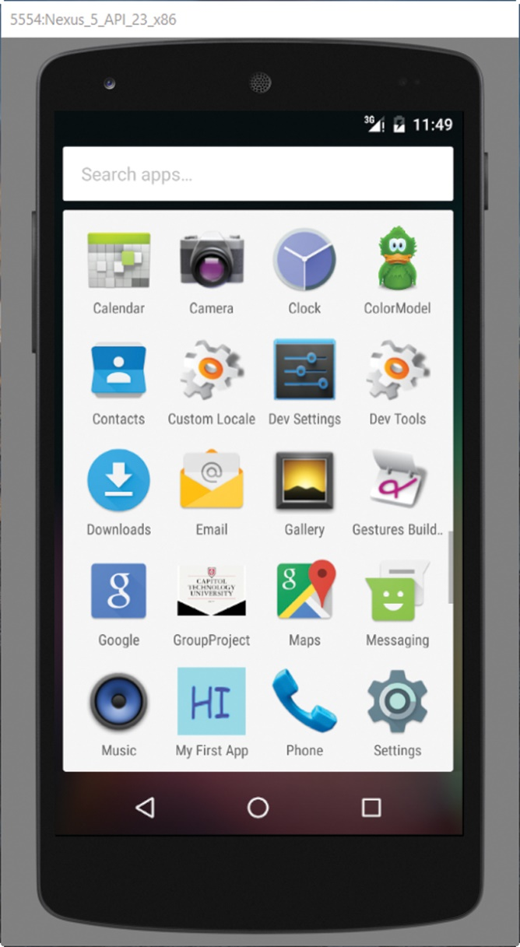
Launcher Icon (2 of 2)
When we run an app inside a device, the app is automatically installed.
If we included an icon, we can see the app among the various app icons of the device.

Slide 98
Orientation (1 of 2)
Sometimes, we want the app to run in only one orientation, vertical for example, and therefore we do not want the app to rotate when the user rotates the device.
Inside the activity element, we can add the android:screenOrientation attribute and specify either portrait or landscape as its value.

Slide 99
Orientation (2 of 2)
For example, if we want our app to run in vertical orientation only, we add:
android:screenOrientation="portrait“
Note that we can control the behavior of the app on a per activity basis.
In this app, there is only one activity, but there could be several.

Slide 100
Gradle Build System (1 of 2)
Android Application Package (APK), is the file format for distributing applications that run on the Android operating system.
The file extension is .apk.
To create an apk file, the project is compiled and its various parts are packaged into the apk file.
At the time of this writing, the apk file can be found in the projectName/app/build/outputs/apk directory.

Slide 101
Gradle Build System (2 of 2)
Apk files are built using the gradle build system, which is integrated in the Android Studio environment.
When we start an app, the gradle build scripts are automatically created.
They can be modified to build apps that require custom building.

Slide 102
Hello Android
Android Studio
The XML layout file: activity_main.xml
Other XML files: strings.xml, styles.xml, dimens.xml, colors.xml.
Running inside the emulator
Running on a device
The Activity (MainActivity) class
Logcat output, Debugger.

